Slide 1
Skytrax Review Analysis: Unleashing Sentiment Insights from Airline Feedback
By Christian De Los Santos

Slide 2
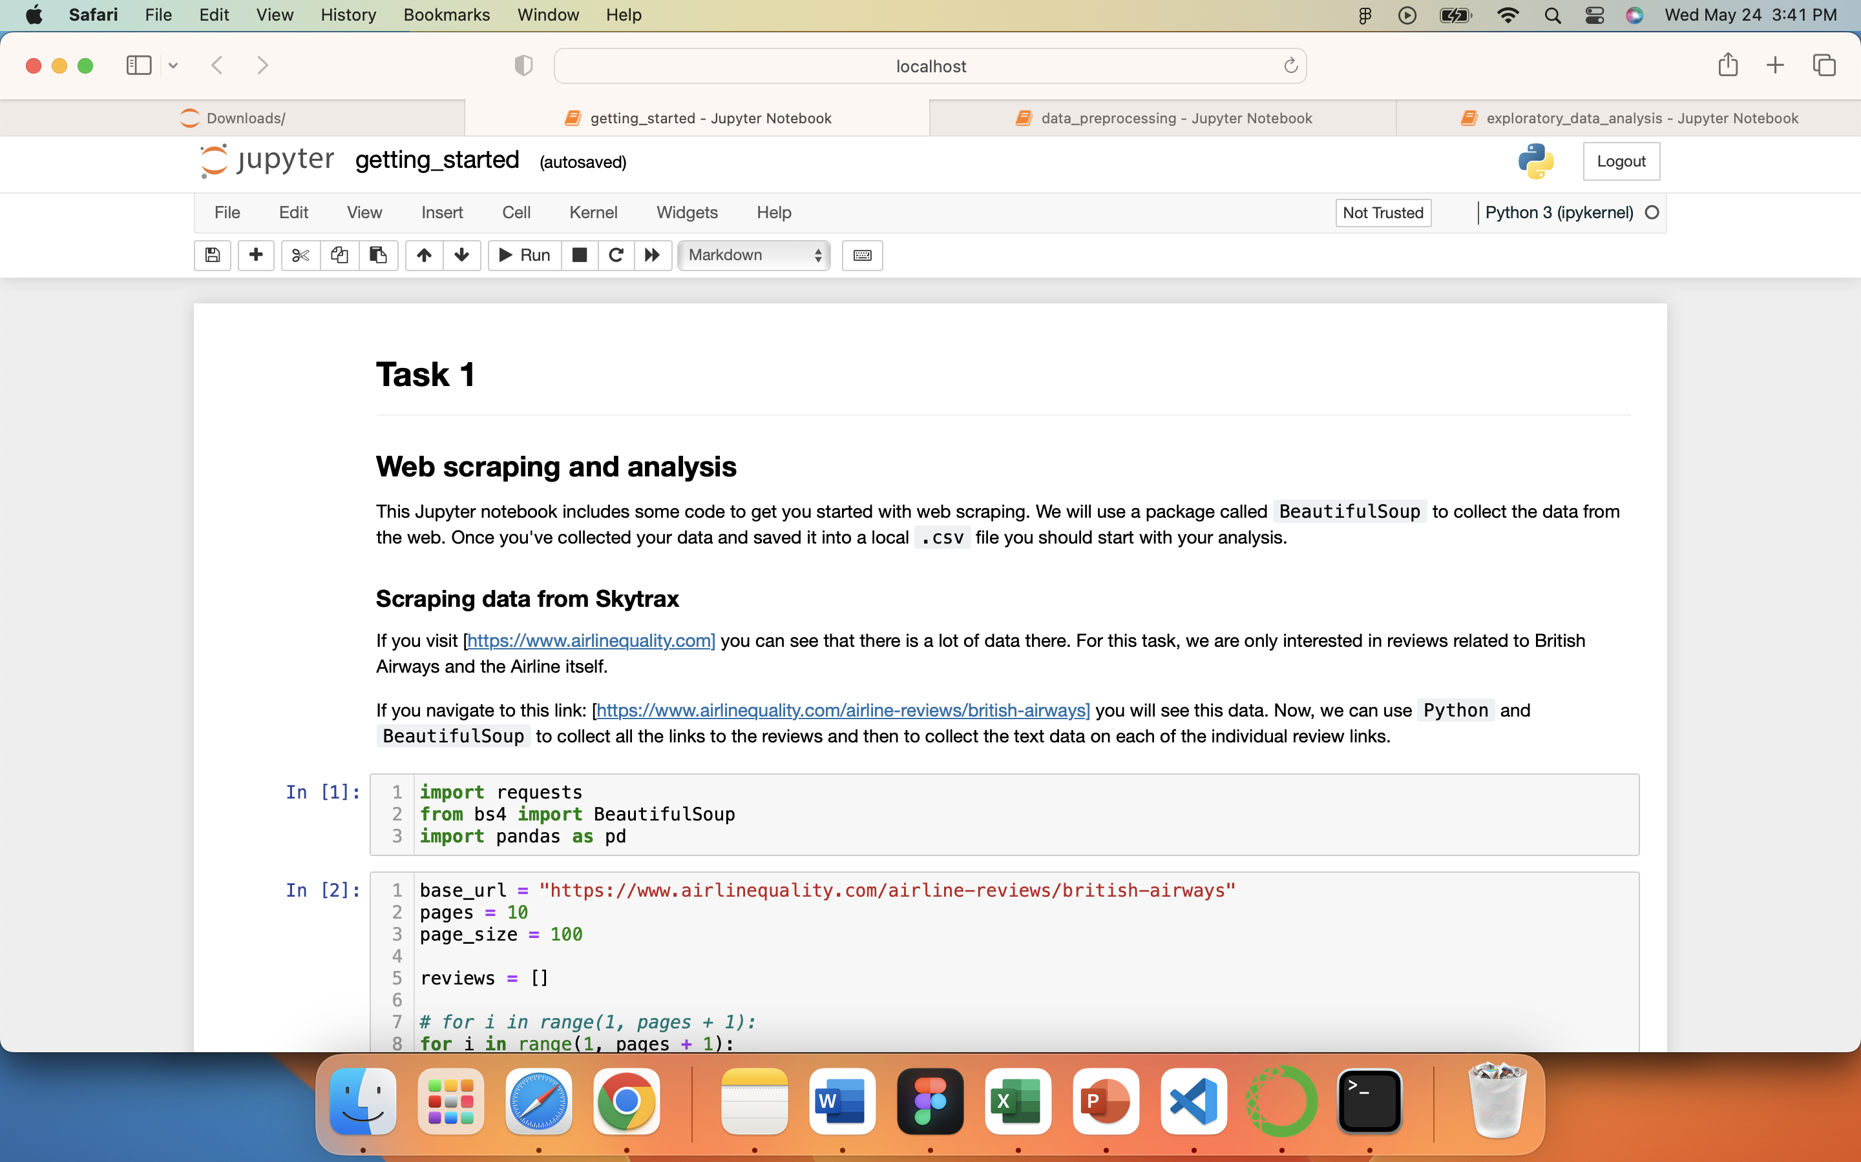
WEB SCRAPING

Slide 3
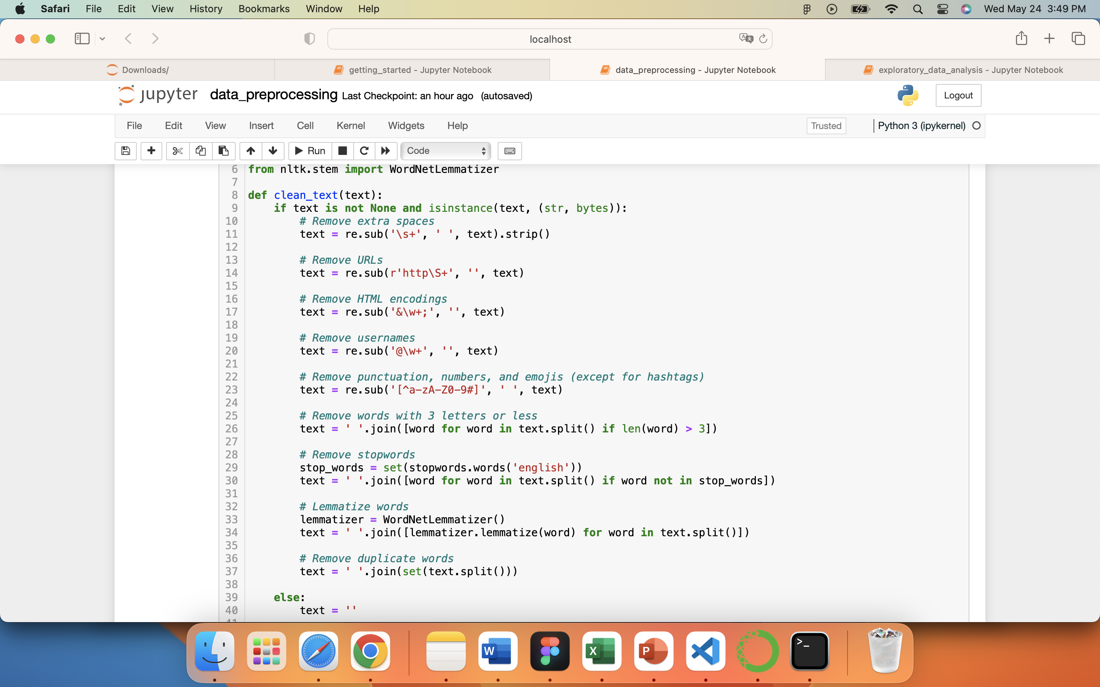
DATA PREPROCESSING
Text cleaning is a vital preprocessing step that involves removing unnecessary elements from the text, such as URLs, usernames, punctuation, numbers, and emojis, to refine the data. By eliminating these elements and performing tasks like lemmatization and removing stopwords, the text becomes more suitable for analysis and interpretation.
Remove extra spaces
Remove URLs
Remove HTML encodings
Remove usernames
Remove punctuation, number and emojis
Remove stopwords
Lemmatize words
Remove duplicate words

Slide 4
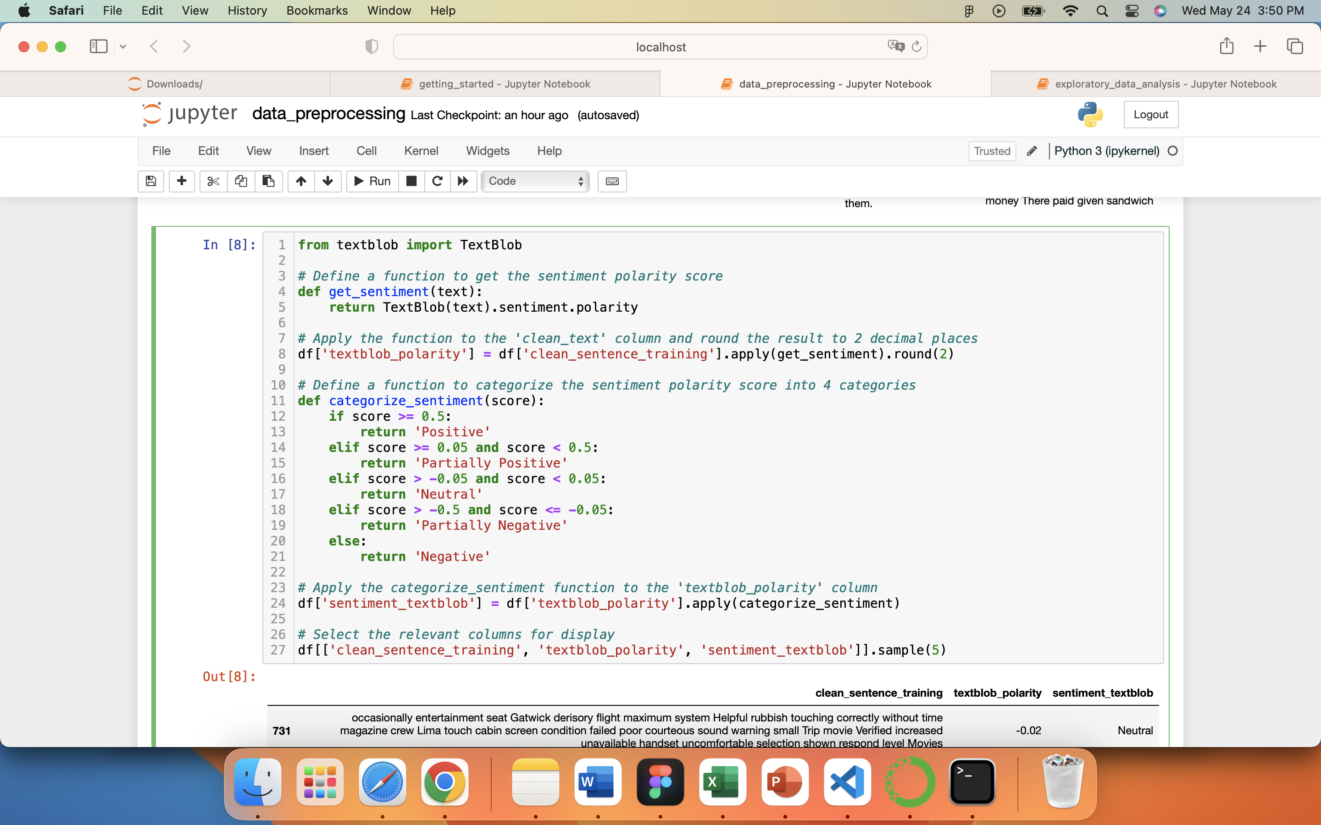
DATA PREPROCESSING
The code snippet utilizes TextBlob library to analyze sentiment polarity of text data. It calculates the polarity score for each sentence in the 'clean_sentence_training' column and categorizes it into positive, partially positive, neutral, partially negative, or negative sentiment based on predefined thresholds. A sample of five rows including the cleaned sentence, polarity score, and sentiment category is displayed.

Slide 5
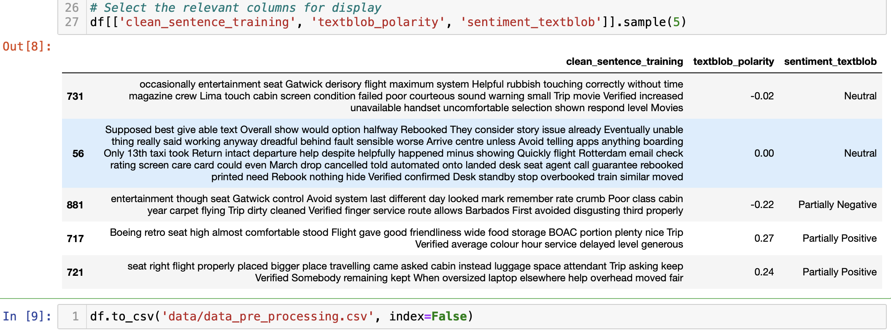
DATA PREPROCESSING
Demonstrates the process of cleaning text data, analyzing sentiment using TextBlob, and saving the results to a CSV file. It applies text cleaning techniques and calculates the sentiment polarity score for each sentence. The resulting data, including the cleaned sentence, polarity score, and sentiment category, is then saved to a CSV file.

Slide 6
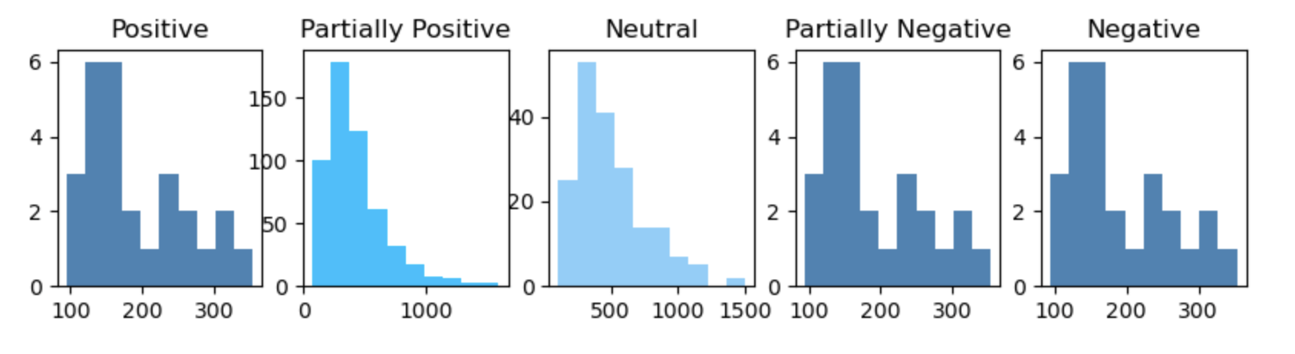
EXPLORATORY DATA ANALYSIS
Presents a histogram visualization of the length of sentences categorized based on sentiment using TextBlob. The plot consists of five subplots, each representing a sentiment category: Positive, Partially Positive, Neutral, Partially Negative, and Negative. The x-axis represents the length of the sentences, and the y-axis represents the frequency of sentences with a particular length. The histogram for the "Partially Positive" sentiment category shows a higher frequency compared to the other sentiment categories, indicating that the majority of sentences in the dataset fall into this category.

Slide 7
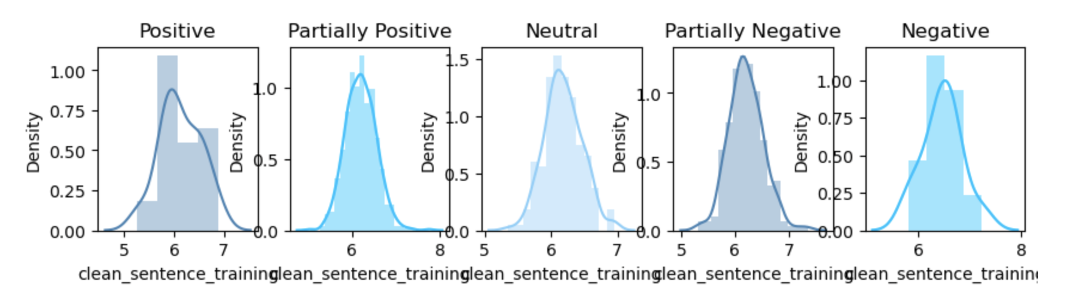
EXPLORATORY DATA ANALYSIS
Visualizes the distribution of the average word length in sentences categorized by sentiment using TextBlob. The plot consists of five subplots, each representing a sentiment category: Positive, Partially Positive, Neutral, Partially Negative, and Negative. The x-axis represents the average word length, and the y-axis represents the density of sentences with a specific average word length. The histogram for the "Neutral" sentiment category exhibits a higher density compared to the other sentiment categories, indicating that sentences categorized as "Neutral" tend to have a higher average word length.

Slide 8
EXPLORATORY DATA ANALYSIS
Visualizes the distribution of sentiment labels using a horizontal bar chart. The y-axis represents the sentiment labels (Partially Positive, Partially Negative, Neutral, Positive, Negative), and the x-axis represents the count of each sentiment label in the dataset. The chart provides a quick overview of the distribution of sentiment labels, with the highest count belonging to the "Partially Positive" category (534 occurrences), followed by "Partially Negative" (238 occurrences), "Neutral" (189 occurrences), "Positive" (27 occurrences), and "Negative" (12 occurrences).
Additionally, the percentages of each sentiment label are displayed below the bar chart. These percentages indicate the proportion of each sentiment label in the dataset. For example, "Partially Positive" accounts for 53.40% of the dataset, "Partially Negative" accounts for 23.80%, "Neutral" accounts for 18.90%, "Positive" accounts for 2.70%, and "Negative" accounts for 1.20%.

Slide 9
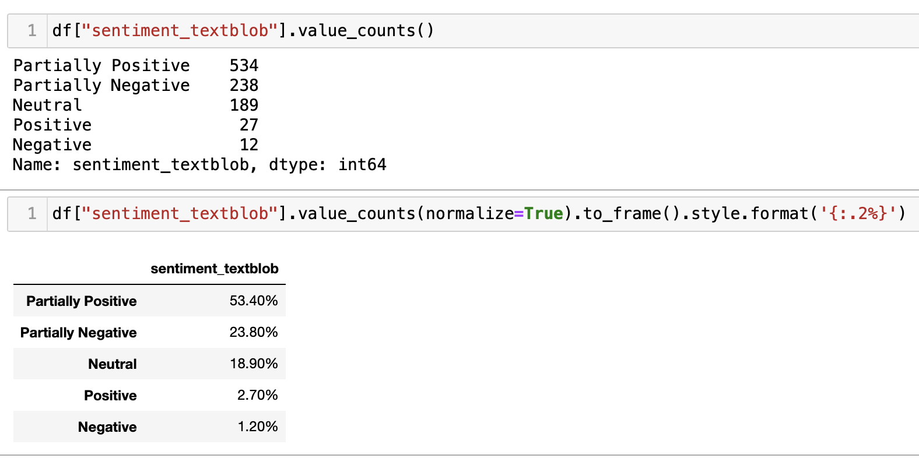
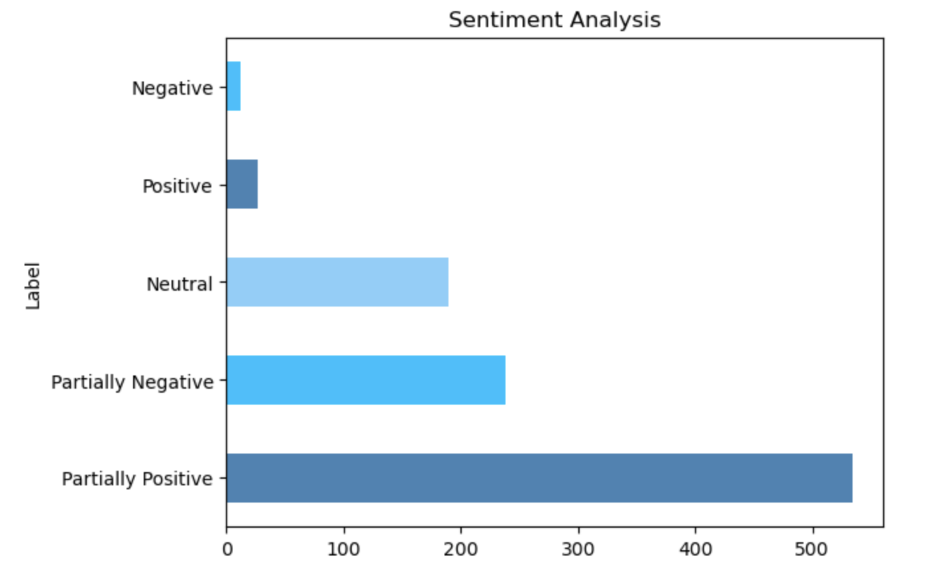
EXPLORATORY DATA ANALYSIS

Slide 10
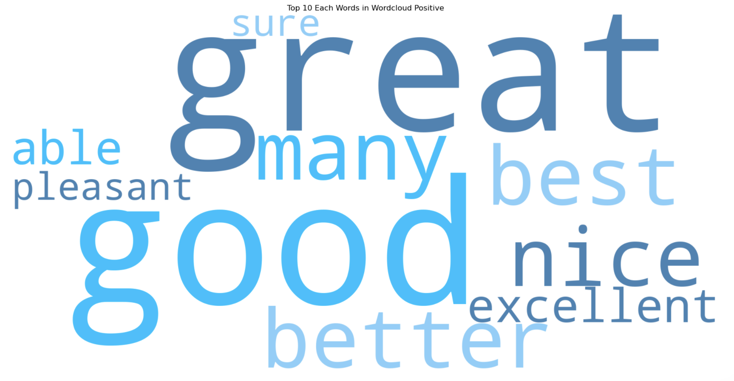
EXPLORATORY DATA ANALYSIS
Positive Wordcloud

Slide 11
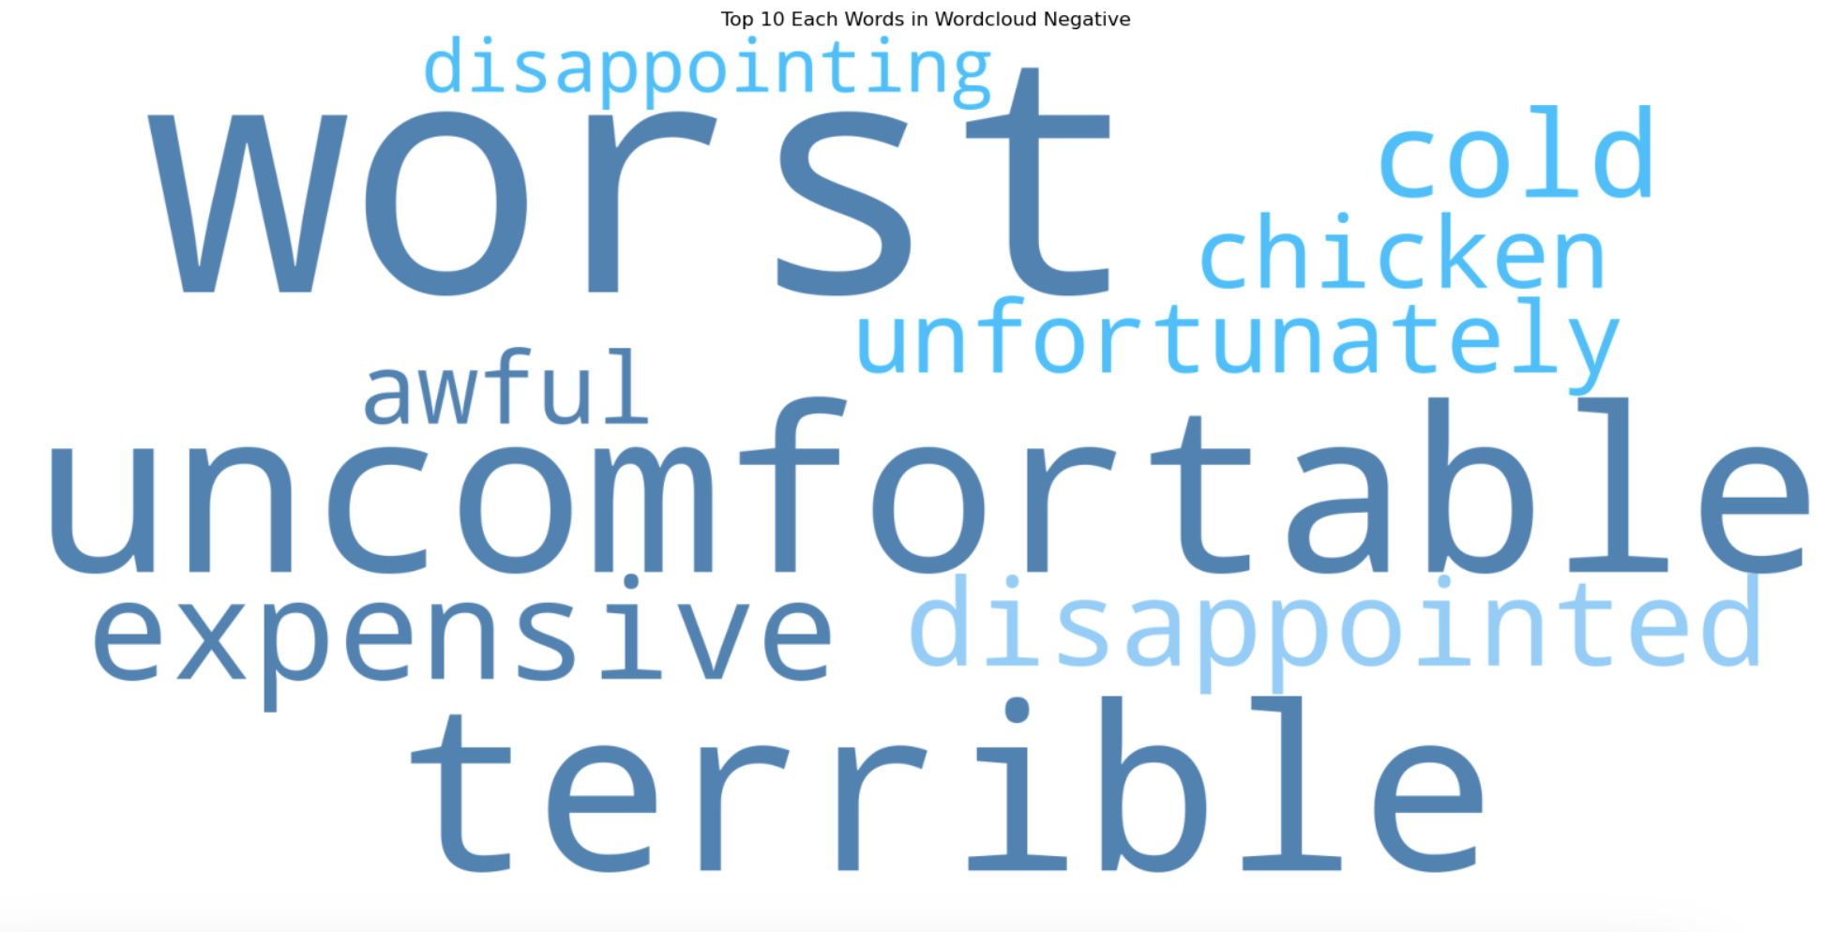
EXPLORATORY DATA ANALYSIS
Negative Wordcloud

Slide 12
THANK YOU

